Slide 1
RUNGTA COLLEGE OF DENTAL SCIENCES & RESEARCH
DIET AND NUTRITION
DEPARTMENT OF PEDODONTICS AND PREVENTIVE DETISTRY

Slide 2
Specific learning Objectives
Core areas | Domain
Introduction Definitions Diet Vitamins Minerals | Nutritional consideration Nutritional assesement of child Nutritional management Diet counselling

Slide 3
Category
MUST TO KNOW
NEED TO KNOW
Recommended dietary allowance. [RDA]
DESIRE TO KNOW
Food group guides
.
Food guide pyramid.
Dietary goals.
Energy for physical activity
Basal metabolism and basal metabolic rate.
Specific dynamic action of food.

Slide 4
contents
Introduction
Definitions
Diet
Vitamins
Minerals
Nutritional consideration
Nutritional assesement of child
Nutritional management
Diet counselling
Conclusion

Slide 5
Introduction
Disease etiology
Cigarette smoking
Sedentary lifestyle
Inappropriate diet
Whatever we eat is a major factor in determining both the quantity and quality of our lives and the basis of this is established early in life.
There are many ways in which health professionals can promote the health of their patients.
Mc donald, Avery, Dean. Dentistry for the child and adolescent, 8th edition.

Slide 6
Definition (DIET)
NIZEL
Total oral intake of a substance that provides nourishment & supply.
P.M RANDELPH
DCNA
It is the total intake of substance that furnish nourishment & calories to the body.
Defined as combination of food consumed and the nutrients contained there in, having the profound ability to influence cognition, behavior, & ultimate physical growth & development.
Nizel AE. Papas AS.Nutrition in clinical dentistry; 3rd edition

Slide 7
Food
Energy
Chemical
Mechanical
Electrical
Thermal
Measure of energy value of food
kilocalories (def)
SI – joule
1 kcal = 4.18 kJ
Nizel AE. Papas AS.Nutrition in clinical dentistry; 3rd edition

Slide 8
Basal metabol-ism
Physic-al activity
Overall energy need
SDA
Basal metabolism :
Minimum amount of energy needed to regulate and maintain the involuntary essential life processes viz breathing, blood circulation, pumping of heart, homeostasis, temperature regulation etc.
BMR: kcal/m2/hr
Nizel AE. Papas AS.Nutrition in clinical dentistry; 3rd edition

Slide 9
Diet
Carbohydrate
Lipids
Macro minerals
Proteins
Water & electrolytes
Vitamins
Minerals
Trace minerals

Slide 10
carbohydrate
Carbohydrates are polyhydroxy aldehydes or ketones.
Consist of carbon, hydrogen, & oxygen
Emperical formula C_{n}H₂O_{n}
Main source of energy in the body.
“Currency of the body”.
Yeild 4 kcal/gm energy.
Nizel AE. Papas AS.Nutrition in clinical dentistry; 3rd edition

Slide 12
Functions of carbohydrates:
Most abundant dietary source of energy.
Brain and RBCs especially.
They are structural component of many organisms.
Participate in the structure of cell membrane and functions viz cell gowth, adhesion, fertilization.
Furnish fibres for peristalsis.
Provides energy to oral and intestinal micro-organisms.
Facilitate oxidation of fats.
Spares proteins.
Serve as storage form of energy.
Nizel AE. Papas AS.Nutrition in clinical dentistry; 3rd edition

Slide 13
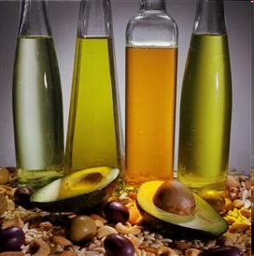
lipids
Heterogenous group of organic compounds related to fatty acids.
Relatively insoluble in water.
Stored in – adipocytes.
Polar and non-polar groups that confer hydrophobic and hydrophilic properties to the lipids.
Yeild – 9 kcal/gm energy.

Slide 14
Lipids
Simple
Fats / oils and Waxes
Complex
Phospholipids, Glycolipids, Lipoproteins
Derived
Miscellaneous
Essential fatty acids
Linoleic acid
Linolenic acid
Arachidonic acid

Slide 15
Functions of lipids
Excellent source of energy.
Phospholipids are integral component of cell membrane & regulates permeability.
Essential fatty acids are needed for normal growth, cholesterol metabolism and to maintain the integrity and function of cell membrane.
Fats act as precursors for synthesis of bile salts, steroids and prostaglandins.
Act as carriers and facilitate transport of various vitamins.
Maintain body temperature by insulating against cold.
Protect vital organs from injury providing cushioning mechanism.
Nizel AE. Papas AS.Nutrition in clinical dentistry; 3rd edition

Slide 16
Fats and oral health
Indirect evidence – reduce caries in human. (Eskimos)
Probable mechanism-
Oily coating on tooth surface – less retention of food.
A fatty protective layer on plaque – prevent fermentable sugars from being reduced to acids.
High concentration of FA may interfer with bacterial growth.
Increased dietary fat intake will reduce the dietary intake of carbohydrates necessary for acid production.
Nizel AE. Papas AS.Nutrition in clinical dentistry; 3rd edition
Ernest newburn; Cariology; 3rd edition

Slide 17
proteins
Large complex molecules containing C, H, O and N.
Chemically they consist of a no. of amino acids held together by peptide linkages.
Yeild – 4kcal/gm energy

Slide 18
Protein nutrition in oral health
Adequate protein diet during pregnancy – needed for proper development of the bones and teeth of the child.
After birth, protein is a basic factor in the growth and development of the oral cavity, like every other tissue since proteins serve as building blocks for tissues.
Children suffering from protein calorie malnutrition
delayed eruption
hypoplastic deciduous teeth
crowded and rotated teeth.
Nizel AE. Papas AS.Nutrition in clinical dentistry; 3rd edition

Slide 19
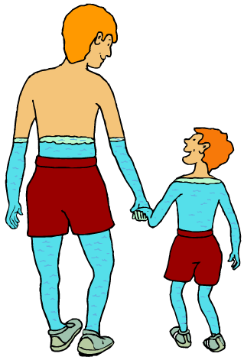
water
The body is mainly composed of water.
Water is a vital nutrient crucial to every bodily function and second only to O₂ in importance to the body.i
It serves as suitable medium for chemical reactions in the body.
It serves as a solvent and vehicle to transport inorganic solvents.
60%
80%
Nizel AE. Papas AS.Nutrition in clinical dentistry; 3rd edition

Slide 20
water
Water plays an integral part in regulating our body temperature when exercising.
When we exercise, the body secretes water as sweat. As the sweat evaporates off our skin, it takes heat with it, helping the body to stay cool.
We also lose water through breathing. This is why glass mists up when we breathe on it – the water vapour in our breath condenses on the cold surface.
Nizel AE. Papas AS.Nutrition in clinical dentistry; 3rd edition

Slide 21
Water and oral health
Like other soft tissues in the body, oral mucosa has a high water content (70 - 80%)
Any systemic factor that produces dehydration or retention of water will cause shrinkage or edema of the oral mucosa.
Dehydration – decreased salivary flow.
Xerostomia - * lack of lubrication of mucosal surface
* burning sensation – palate and tongue
* cracked corners – infection
* dental caries.
* increased plaque formation – gingival irritation
Nizel AE. Papas AS.Nutrition in clinical dentistry; 3rd edition

Slide 22
VITAMINS
Vitamins are organic compounds essential in the diet to promote growth and health maintenance and normal metabolic functioning of the body.
Frederick G. Hopkins (1906)
Casimir Funk - vitamin
Do not contribute directly to the body structure, nor supply energy.
They regulate metabolism.
Usually act as coenzymes.
Nizel AE. Papas AS.Nutrition in clinical dentistry; 3rd edition

Slide 23
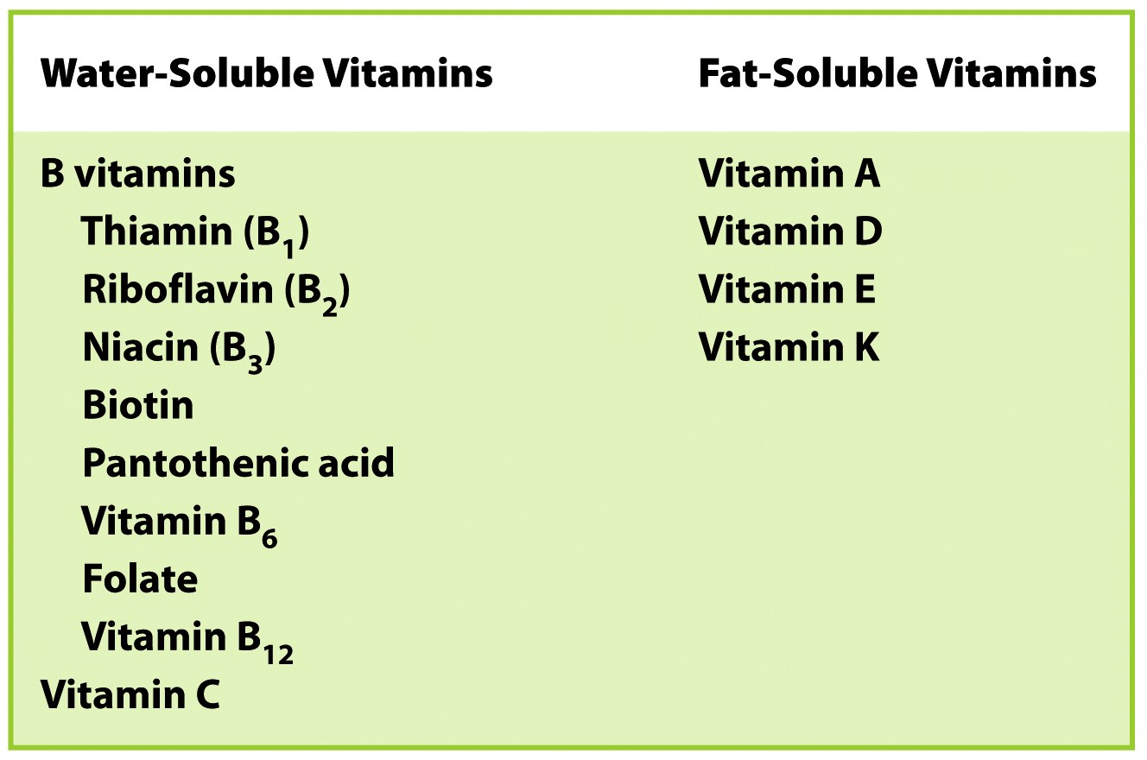
Nizel AE. Papas AS.Nutrition in clinical dentistry; 3rd edition

Slide 24
vitamin B COMPLEX
11 different vitamins are discovered.
On functional basis, classied as
Release energy from carbohydrates and fats
Thiamine, Riboflavin,
Pantothenic acid, Niacine
Catalyse RBCs formation
Folic acid
Protein and A.A. metabolism
Biotin
Vit B 12
Vitamin like compound
Vitamin B 6
Choline
PABA
Nizel AE. Papas AS.Nutrition in clinical dentistry; 3rd edition

Slide 25
Beriberi
Wet
Edema of legs
Cvs disorders
Distended neck veins
Inadequate thamine in breast milk.
Infantile
Dry
Dyspnea, cyanosis, cardiac failure.
Possible oral manifestations :
Increased sensitivity of oral mucosa
Burning tongue
Loss of taste.
Nizel AE. Papas AS.Nutrition in clinical dentistry; 3rd edition

Slide 26
